Slide 1
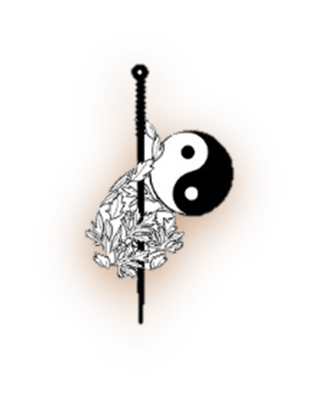
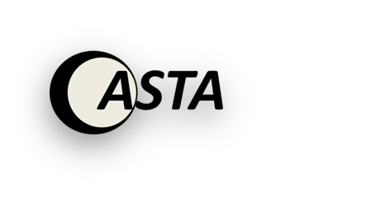
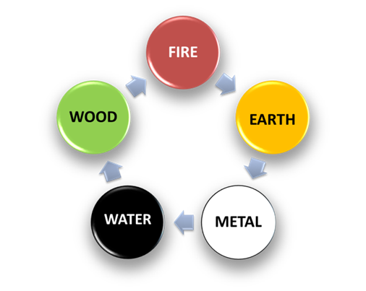
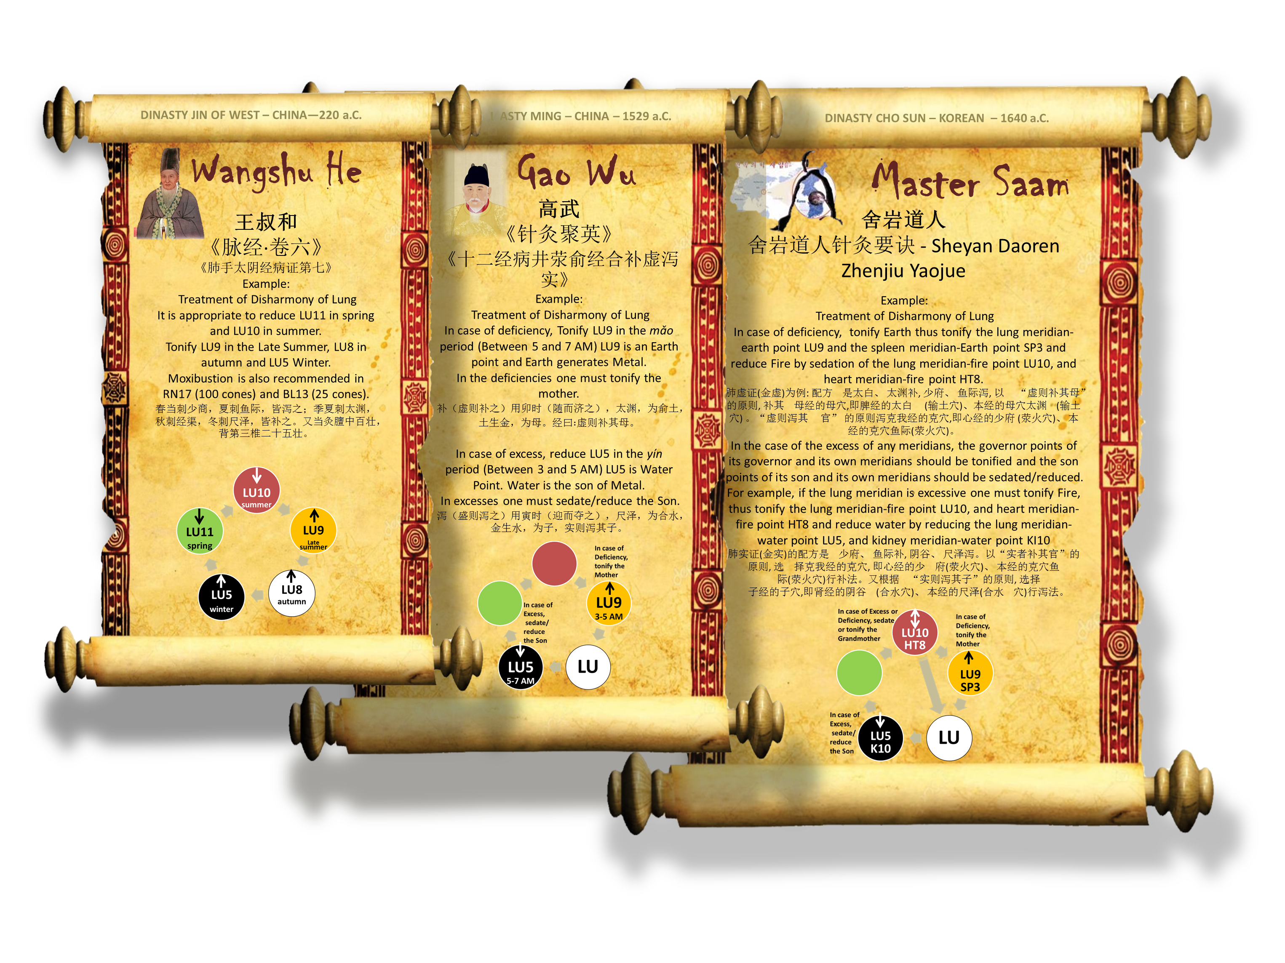
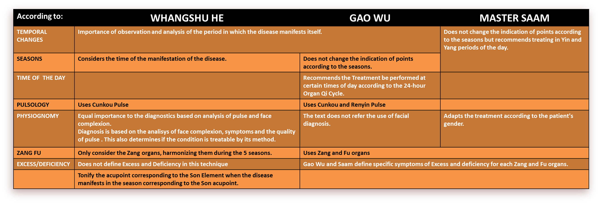
2017 Annual Conference of China Association of Acupuncture & Moxibustion
DEC 2 – 4 , 2017 Loong Palace Hotel & Resort, Beijing China
A Comparative Analysis of the use of Five Transport Points (五输穴) in Three Classical Acupuncture Techniques
CEATA
Ferreira Medeiros Ephraim ¹; Andrada Luiz ²
1 CEATA Acupuncture, Shiatsu and Alternative Therapies Study Center – São Paulo – Brazil
2 CASTA Acupuncture, Shiatsu and Alternative Therapies Study Center – Niterói - Brazil
The category of Five Transport Points (五输穴 Wu Shu Xue) has been used in the construction and design of distinct acupuncture treatment methods
throughout history that emerged from different interpretations of the
fundamental theories of 黄帝内经 - Huangdi Neijing》 and The Yellow
Emperor‘s Canon of 81Difficult Issues 《黄帝八十一难经 Huangdi
Bashiyi NanJing》.Chapter 1 of Ling Shu (灵枢经-九针十二原 ) defines
the Five Transport Points and correlates them to the Zang Fu organs.
Chapter 2 of Ling Shu (灵枢经-本输) Discusses the particular relationship
between the Five Transport Points with each of the Zang Fu organs and also correlates the Jing (井) points of the channels with the Five Movements/
Elements (五行) Chapter 44 of Ling Shu (灵枢经- 顺气一日分为四时)
INTRODUCTION
defines the function of the Five Transport Points and also defines the correlation
between the Twenty Five Transport Points and the Five Seasons of the
year. The Issues 64, 65, 66, 74 of the The Yellow Emperor‘s Canon of
81 Difficult Issues 《黄帝八十一难经 Huangdi Bashiyi NanJing》
define the correlation between the Five Transport Points and the
Five Elements, seasons, directions, etc.
Example : Issue 64 :
六十四难曰 “ 阴井木，阳井金，阴荥火，阳兴水，阴输土 阳输
木，阴经金，阳经火，阴合水，阳合土”。 Nan Jing Issue 69 defines the rule:
"Reinforce Mother in deficiency and sedate Son in excess.“
“六十九难曰 : ...虚者补其母，实者泻其子，当先补之，然后泻之”。
ANALYSIS
We analyzed the "Acupuncture and Moxibustion Method for Treating Patterns of Diseases of the 5 Zang during the Four Seasons" (五脏病证的四时针灸方法) described in roll 6 of the Pulse Classic by Wang Shuhe- 王叔和《脉经·卷六》 and the acupuncture method described in chapter 《十二经病井荥俞经合补虚泻实》of the work Collection
of gems in Acu- Moxibustion 《针灸聚英- Zhenjiu juying》 written by Gao Wu 高武 and the 4 points Method (also known as "8 Needles Method“) described by Saam (or Sheyan -舍岩) in his work Essential Rhymes on Acupuncture and Moxibustion by Master Saam《舍岩道人针灸要诀 - Sheyan Daoren Zhenjiu Yaojue》.
The category of Five Transport Points (五输穴 Wu Shu Xue) has been used in the construction and design of distinct acupuncture treatment methods throughout history that emerged from different interpretations of the fundamental theories of 《黄帝内经 - Huangdi Neijing》 and The Yellow Emperor‘s Canon of 81 Difficult Issues 《黄帝八十一难经Huangdi Bashiyi NanJing》. We found that Wang Shuhe 王叔和 changes the prescription and method of stimulation using tonification or sedation of a pair of point selected from the 5 transport points during the 5 Seasons. The acupuncture
method developed by Gao Wu 高武
advocates the use o acupuncture methods
COMPARATIVE TABLE OF THE 3 TECHNIQUES
aiming to tonify the deficiency and to sedate the excess on the basis of either depletion or repletion of the generation cycle（生- Shen）and Saam further developed the method of Gaowu by adding the control cycle (克- Ke). On the basis of Gao-Wu and Zhang Shi Xian treatment, Saam added the role of the governor. This notion originated from the 50th and 75th issues of the The Yellow Emperor’s Canon of 81 Difficult Issues 《黄帝八十一难经 Huangdi Bashiyi NanJing
BIBLIOGRAPHY
: 1 - Park, Manyong & Kim, Sungchul. (2015). A Modern Clinical Approach of the Traditional Korean Saam Acupuncture. Evidence-based complementary and alternative medicine : eCAM. 2015. 703439. 10.1155/2015/703439. 2- Kwon, Hyo-Jung & Kim, Yong-Suk. (2015). General Guide for Korean Acupuncture & Moxibustion. Open Journal of Immunology. 05. 90-103. 10.4236/oji.2015.53010. 3 - 《古今针灸治验精华 》陈克正 - 中国中医药出版社, 2012, p.59 4 - Ctext.org. (2017). 针灸聚英 : 卷二 - Chinese Text Project. [online] Available at: http://ctext.org/wiki.pl?if=en&chapter=509040&remap=gb#p54

